Slide 1
Writer Verification on Multi-Language Script using Deep Learning
Project by
Souporno Ghosh
Soumya Nasipuri
Rahul Roy
Sharanya Saha
Under the Guidance of
Prof. Jaya Paul

Slide 2
Next Presenter: Sharanya Saha
Motivation, Software Used, Hardware Used, Significance of Hardware, Background, Summary of Present Work, Our Contribution

Slide 3
Motivation
Shortage of Research in Native Indian Language Recognition
Authentication of Manuscripts
Forensic Analysis and Law Enforcement
Plagiarism Verification

Slide 4
Software Used
Python 3.8
TensorFlow 2.0
Keras
NumPy
Pandas
Matplolib
SeaBorn

Slide 5
Hardware Used
HP Pavilion with 2.7GHz Quad-Core Intel i5, Integrated Graphics Card, 8GB RAM
Dell G3 with 2.6GHz Hexa-Core Intel i7 Processor, Integrated Graphics Card, 8GB RAM
Asus Vivobook 2GHz Quad-Core AMD Ryzen 5 Processor, Integrated Graphics Card, 8GB RAM

Slide 6
Significance of the Hardware
RAM and Processor for Processing Speed
GPU Might Help!
Cloud Platforms is a great alternative!

Slide 7
Background
Works on Image Recognition and CNN
ImageNet classification with deep Convolutional Neural Networks [1]
Very Deep Convolutional Networks for Large-Scale Image Recognition [2]
Works on Character Recognition
Automatic Visual Features for Writer Identification: A Deep Learning Approach [3]
Handwritten Character Recognition of South Indian Scripts: A Review [4]
A High Performance Domain Specific Ocr For Bangla Script [5]
Bangla character recognition based on Mobilenet v1 and Inception v3 [6]
CNN implementation based on Bangla numeral character recognition [7]
Works on Writer Recognition
Offline writer identification using convolutional neural network activation features [8]
Writer identification using an HMM-based handwriting recognition system: To normalize the input or not [9]
Offline Text-Independent Writer Identification Based on Scale Invariant Feature Transform [10]
Notes:
To decide what approach we should take to recognize the writer from the handwriting, we decided to survey related articles.
#First, we look into image recognition basics to find out the best way to approach the image recognition problem.
-We looked into the validity of Deep Convolutional Neural Networks for image recognition as discussed by Krizhevsky et al.
-Additionally, we refered the original article where the VGG16 was first proposed. We will be discussing about VGG16 in details later in this presentation.
#To understand how handwriting can be treated as images, we looked into articles on handwritten character recognition. -we referred to Rehman et all, which is about Arabic Character Recognition.
-we also referred to John et al, which is about south Indian script recognition.
-Coming to the next article, Hasnat et al. proposed a domain specific OCR which classify machine printed as well as handwritten Bangla characters. For classification, Hidden Markov Model (HMM) was used.
-Finally, Paul et al. has attempted Bangla character recognition with Mobilenet v1 and Inception v3 and Bangla number recognition with Convolutional Neural Networks.
#now we will be looking at works on Writer Recognition -Christlein et al. attempted author recognition with Convolutional Neural Network.
-Schlapbache et al. analysed HMM based handwriting recognition systems and studied the effect of normalisation operations
-Lastly, Wu et al. attempted writer identification on English and Chinese languages
While the works are different from what we are trying achieve, they help us find an appropriate way to approach our problem.

Slide 8
Summary of Related Work
Lack of Work specific to Bangla
Reference | Year | Model | Type | Dataset | Result (%)
Adak et al. [11] | 2019 | VGG16 | Verification | Self Procured | 97.77
Christlein et al. [8] | 2015 | CNN (Super Vector encoded) | Identification | Self Procured | 88.60
Schlapbach et al. [9] | 2006 | Hidden Markov Model | Identification | Self Procured | 63.12
Wu et al. [10] | 2014 | SDS + SOH | Identification | Multiple | 99.2
Table 1. Type of Work
Notes:
#Now, we will be discussing a summery of the works which we are referring.
#As mentioned earlier, the work done in the field of Bangla character recognition is very limited. For reference and guidance, we looked into the works bellow in a tabular form.
#As it is visible that, these are the authors we took reference of and these are the models they have used, Cristlein et al., Schlapbach et al., and Wu et al. have worked on Identification of Authors and only Adak et al. have worked on verification of Author, but the scope of our project was verification, so we are using the VGG16 model as used by Adak et al and try to improvise it. CNN: A Convolutional Neural Network also known as ConvNet is a Deep Learning algorithm which can take in an input image, assign importance to various aspects or objects in the image and be able to differentiate one from the other. Pattern recognition, age detection
Super vector: Used for more large-scale image categorization. Super vector encoding methods have obtained the state of-the-art performance in several tasks. super vector encoding helps us to achieve the powerful performance on computer vision task.
Hidden Markov Model: It is a combination of Markov chain and a set of observed variables. Used in image processing or natural language processing. Here from the object we can identify the probability of occurring a event (bays theorem). *Transition matrix *observed variables.
Transfer Learning: we are borrowing the weights from a previous model, which was trained using a very big data set and by improvising on that model we are going to produce good results on our new task, which contains smaller dataset.
SIFT descriptor(SDS) is a 3-D spatial histogram of the image gradients in characterizing the appearance of a keypoint. The gradient at each pixel is regarded as a sample of a three-dimensional elementary feature vector, formed by the pixel location and the gradient orientation.
SOH: Scale and orientation histogram
Wu et al. method for automatic offline text-independent writer identification based on SIFT, in which two SIFT features, i.e. SDS and SOH, are extracted from handwriting images to characterize the writer’s individuality
VGG16: (Visual Geometry Group) two layers -> 13 Convolutional base, 3 fully connected layers (dense layer).

Slide 9
Our Contribution through Present Work
Writer verification
Verification on Word Level Features
Percentage of Similarities with the author
Unique Dataset with 100+ volunteers
Notes:
#Lastly I would like to mention our contributions to the present work:
-Here we are taking two samples of writings from unknown authors and check weather they are matching or not.
-While Adak et al’s work used character and stroke level feature, we used word level feature for writer verification
-Adding to Adak et al’s work, we would be measuring the percentage of similarity between the two samples.
-We have an unique dataset which contains writings from more than 100 volunteers.

Slide 10
Next Presenter: Souporno Ghosh
About Data Set, About VGG16
Notes:
That’s my time, now I will hand over the control to Souporno Ghosh and he will discuss more about Data Set and VGG16
Souporno:
Good evening. Thank you, Rahul. I am Souporno and I will take over from here. As Rahul Mentioned, I’ll take a little about the dataset and a little about the VGG16 model.
#

Slide 11
Collection of Data Set
100+ volunteers
2 Language: English, Bangla
Handwritten Passage
Passages scanned into images
Notes:
So, the dataset we used was provided to us by our project supervisor.
# The original Dataset had more than 100 volunteers.
# The dataset had 2 languages: English and Bangla.
# It initially contained handwritten passages.
# The passages were then scanned into digital images. #

Slide 12
Preparation of Data Set
Data Segmented into Word-Sized Images [12]
Data Set Organisation
Each Dataset has 20 Subsets
Every Subset has Data for one Writer; Another writer for verification
Number of writers: 100 for Bangla, 101 for English
5 Sets of Data for Each Author
3 Training Sets and 2 Testing Sets
Average 43 images per Set
Tag Image File Format
Format: <Writer Code>_<Set Number>_<Image Number>
Notes:
Now, before the data can be processed, it needs to be prepared.
# The images of the handwritten passages were segmented into word sized images. Segmentation was done as a final year project by Mondal et al in 2020 in the project titled “Preprocess the handwritten document image for preparing writer recognition”. The Exact methodology of additional image preprocessing will be discussed later in the presentation.
[Noise Removal: Gaussian Blur and Normalisation -> Paragraph Separation: Rectangular Structural Element Filtering -> Word Cropping: Anisotropic filter]
[Tapan Mondal, Suraj Ahmed Hossain, Spandan Mondal, Raihan Afroz, Anowar Hossain]
# The segmented images were then organized in the following way.
# Every Dataset has 20 subsets.
# Every subset has data for one writer along with data for another writer that will be used for verification with the former.
# We have 100 writers for Bangla and 101 for English
# There are five sets of data for each of the writer.
# The five sets are divided into three training sets and two testing sets.
# Each set has an average of 43 images.
# The images are stored as dot TIFF files, that is Tag Image File Format.
# The format of labels of images is Writer Code underscore Set Number underscore Image Number. So the first image of the first set of the first author number is labeled as 0000_01_0.tiff.
#

Slide 13
Example Data
Fig 1. 0000_01_0.tiff
Notes:
This is an example of what the segmented image looks like.
# This is the image labelled 0000_01_0.tiff that I mentioned earlier, that is this is actually the first image of the first set of the first author number.
#

Slide 14
Organization of Extracted Feature Set
Extracted features stored as CSV files
<Language code> added to the stored feature matrix
Language Code for Bangla: 11
Language Code for English: 00
CSV File Name Format: <Writer Code>_<Language Code>_<Set Number>
Notes:
Now, before we will be predicting and verifying the writers, we will need to extract necessary features such as contours, angles, lines, slopes, curvature, dimensions, et cetera. We will discuss the exact methodology for the feature extraction a little later in the presentation. However, we will discuss the organization of the extracted feature sets now
# The extracted features will be stored as Comma Separated Values i.e. CSV files.
# Since we aim to attempt inter-language verification, we have added the language code to the CSV file obtained for the obtained feature matrix corresponding to a writer.
# Language code for Bangla is 11 and Language code for English is 00
# The format of the File Names of the stored CSV files is Author Code underscore Language Code underscore Set Number. So, the CSV file for the first set of Bangla Language written by the first writer is 0000_11_0.csv.
#

Slide 15
About VGG16 Model
Proposed by Simonyan and Zisserman in 2014 [2]
92.7% accuracy with the ILSVRC subset of ImageNet Database
1st and 2nd place in ILSVRC 2014
VGG = Visual Geometry Group
16 Neural Network Layers
13 Convolutional Networks
3 Dense Networks
Takes 224 x 224 pixel Images with RGB as an Input
Notes:
Now we shall talk about VGG16, since it is the primary neural network model that we will be using in our project.
# The VGG16 model was first proposed by Karen Simonyan and Andrew Zisserman of Oxford University’s Visual Geometry Group Lab in a scholarly article titled "Very Deep Networks for Large Scale Image Recognition“ in 2014.
# It has 92.7% accuracy on top 5 accuracy tests with the ImageNet Large Scale Visual Recognition Challenge (ILSVRC) subset of ImageNet database, which contains 150,000 images and 1000 object categories.
# This model won the first and second place in 2014 ImageNet Large Scale Visual Recognition Challenge, that is ILSVRC 2014.
# The VGG in the name stands for Visual Geometry Group, which is the name of the laboratory where the model was conceived.
# The 16 in the name signifies the 16 Neural Network Layers. # Out of these Layers 13 are Convolutional Networks and 3 are Densely connected Networks.
# The model takes 224 cross 224 pixel images in RGB channels as an input.
#

Slide 16
Benefits of VGG16
Very accurate
Simple and Uniform
Popular
Notes:
We chose VGG16 as our primary model because it has certain benefits over other models.
# VGG16 has very high accuracy. As mentioned earlier, it has 92.7% accuracy on top 5 accuracy tests with the ILSVRC subset of Imagenet database.
# VGG16 has a uniform layer structure. Its simplicity and uniformity makes it easier to customise for handwriting recognition.
# VGG16 is also a highly popular algorithm. It is a go-to model for image recognition problems, including handwriting recognition.
#

Slide 17
Challenges of VGG16
Slow to Train
Huge Weights
Notes:
However, despite VGG16 model’s high accuracy, simplicity and popularity for image recognition, it has a couple of unfortunate drawbacks.
# The model is very slow to train. The original VGG model was trained for 2 to 3 weeks on an NVidia Titan GPU. It is for the same reason that it took more than 2 hours to extract features for handwriting recognition on our laptops that lack a GPU
# The model also has very big weights. The size of VGG16 trained ImageNet weights is five hundred and twenty eight MB. So, it takes quite a lot of disk space and bandwidth that makes it inefficient with respect to space.
#

Slide 18
Next Presenter: Soumya Nasipuri
Architecture of VGG16, Feature Extraction, What Comes Next
Notes:
(Now, I’ll hand over control to Soumya. He will discuss more on the model’s architecture, extracting features and what we will have to do after this.
#)
Now, I would have handed over the control to Soumya, but he is absent due to medical reasons. He will be discussing more on the model’s architecture, extracting features and what we will have to do after this on a later date. Thank you for sitting down with us and listening to our presentation.

Slide 19
Image Pre-processing
Raw Tiff Images
Normalisation
Expansion of dimensions from 3D array to 2D array
Resizing
224 x 224 RGB Image

Slide 20
Architecture of VGG16 Model
Input: 224 x 224 RGB Images
2 ConvNets with 64 filters and ReLU Activation Function; Output is MaxPooled
2 ConvNets with 128 filters and ReLU Activation Function; Output is MaxPooled
3 ConvNets with 256 filters and ReLU Activation Function; Output is MaxPooled
3 ConvNets with 512 filters and ReLU Activation Function; Output is MaxPooled
3 ConvNets with 512 filters and ReLU Activation Function; Output is MaxPooled
2 Dense Neural Nets with 4096 units and ReLU Activation Function
1 Dense Neural Net with 1000 units and SoftMax Activation Function
Output: Category (1000 in the ImageNet Database)

Slide 21
Feature Extraction
Input: 224 x 224 RGB Images
2 ConvNets with 64 filters and ReLU Activation Function; Output is MaxPooled
2 ConvNets with 128 filters and ReLU Activation Function; Output is MaxPooled
3 ConvNets with 256 filters and ReLU Activation Function; Output is MaxPooled
3 ConvNets with 512 filters and ReLU Activation Function; Output is MaxPooled
3 ConvNets with 512 filters and ReLU Activation Function; Output is MaxPooled
2 Dense Neural Nets with 4096 units and ReLU Activation Function
1 Dense Neural Net with 1000 units and SoftMax Activation Function
Output: Category (1000 in the ImageNet Database)
Input:
RAW TIFF Images
Image Preprocessing
Output:
Feature Matrix

Slide 22
Extracted Features
Dimensions: 4096 x 1 per image
Consolidated Features for each Set of Images
5 sets of extracted features for each author
Dimensions for Each Extracted Feature Matrix for a Set: 4096 x r
r = number of rows = number of images in each set
Feature extraction time = 2 hours 14 minutes 17 seconds (approx.)

Slide 23
Handwriting Verification
Updated the last layer of VGG16 Model
Trained the model with every writer pair
Distinguish between the handwriting of the primary writer pair and the other writer pairs.

Slide 24
Last layer of VGG16
Updated the last layer of VGG16 Model
Trained the model with every writer pair
Distinguish between the handwriting of the primary writer pair and the other writer pairs.

Slide 25
Next Presenter: Rahul Roy
Accuracy, Conclusion, References

Slide 26
Additional Models
ResNet
AlexNet
In both the models, the output size were reduced to two from their original.

Slide 27
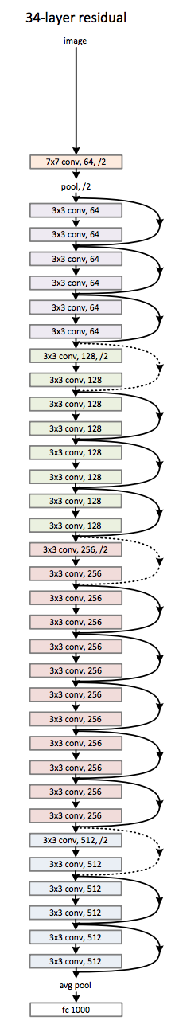
Structure of ResNet

Slide 28
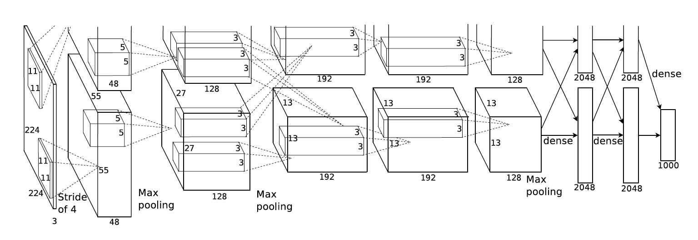
Structure of AlexNet

Slide 29
Accuracy
Final Accuracy: The average accuracy of the obtained accuracies
Model | Final Accuracy
VGG 16 | 62.75%
ResNet | 72.09%
AlexNet | 74.45%
Table 2. Comparing accuracies of different models

Slide 30
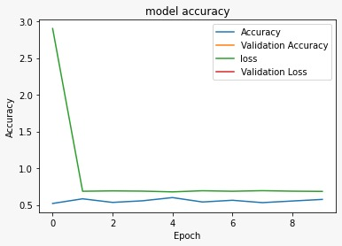
VGG-16
Fig 2. Graph depicting accuracy, validation accuracy, loss and validation loss over multiple epochs

Slide 31
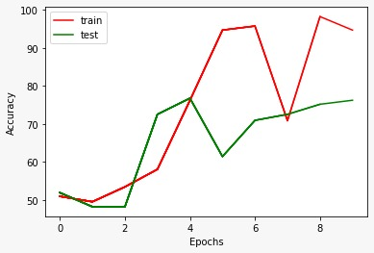
ResNet
Fig 3. Graph depicting accuracy, validation accuracy, loss and validation loss over multiple epochs

Slide 32
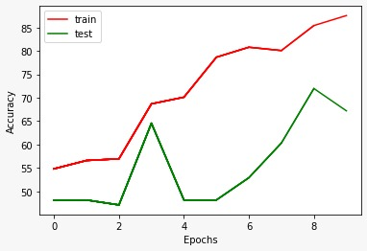
AlexNet
Fig 4. Graph depicting accuracy, validation accuracy, loss and validation loss over multiple epochs

Slide 33
References
[1] A. Krizhevsky, I. Sutskever and G. E. Hinton, “ImageNet classification with deep Convolutional Neural Networks”, Communications of the ACM, Vol. 60 Issue 6, pp. 84–90, May 2017, doi: 10.1145/3065386.
[2] K. Simonyan and A. Zisserman, “Very Deep Convolutional Networks for Large-Scale Image Recognition”, in Proc. International Conference on Learning Representations (ICLR 2015), 2015 [Online], Available: http://arxiv.org/abs/1409.1556.
[3] A. Rehman, S. Naz, M. I. Razzak and I. A. Hameed, "Automatic Visual Features for Writer Identification: A Deep Learning Approach," IEEE Access, Vol. 7, 2019, pp. 17149-17157, Jan. 21, 2019, doi: 10.1109/ACCESS.2018.2890810.
[4] J. John, Pramod K. V. and K. Balakrishnan, “Handwritten Character Recognition of South Indian Scripts: A Review”, in Proc. National Conference on Indian Language Computing, Feb. 19-20, 2011.
[5] M. A. Hasnat, S. M. Habib, M. Khan, Eds., “A High Performance Domain Specific Ocr For Bangla Script”, Novel Algorithms and Techniques In Telecommunications, Automation and Industrial Electronics, Dordrecht: Springer, 2008, doi: 10.1007/978-1-4020-8737-0_31.
[6] J. Paul, A. Roy and A. Sarkar, “Bangla character recognition based on Mobilenet v1 and Inception v3”, in Proc. International Conference on Emerging Technologies for Sustainable Development (ICETSD ‘19), Mar. 5-6, 2019, pp. 511-514.

Slide 34
Reference
[7] J. Paul, A. Dattachaudhuri and A. Sarkar, “CNN implementation based on Bangla numeral character recognition”, in Proc. International Conference on Emerging Technologies for Sustainable Development (ICETSD ‘19), Mar. 5-6, 2019, pp. 520-523.
[8] V. Christlein, D. Bernecker, A. Maier, and E. Angelopoulou, ‘‘Offline writer identification using convolutional neural network activation features,’’ In Proc. German Conf. Pattern Recognition, 2015, pp. 540–552. DOI:10.1007/978-3-319-24947-6_45.
[9] A. Schlapbach and H. Bunke, ‘‘Writer identification using an HMM-based handwriting recognition system: To normalize the input or not,’’ in Proc. Conf. IGS, 2005, pp. 138–142.
[10] X. Wu, Y. Tang and W. Bu, "Offline Text-Independent Writer Identification Based on Scale Invariant Feature Transform," in IEEE Transactions on Information Forensics and Security, vol. 9, no. 3, pp. 526-536, March 2014, DOI: 10.1109/TIFS.2014.2301274.
[11] C. Adak, B. B. Chaudhuri and M. Blumenstein, “An Empirical Study on Writer Identification and Verification from Intra-Variable Individual Handwriting”, IEEE Access, Vol. 7, 2021, pp. 24738-24758, Feb 18, 2019, doi: 10.1109/ACCESS.2019.2899908.
[12] T. Mondal, S. A. Hossain, S. Mondal, R. Afroz and A. Hossain, “Preprocess the handwritten document image for preparing writer recognition”, Government College of Engineering and Leather Technology, Kolkata, India, Project Report, June 2020.

Slide 35
References
[13] R. Thakur, “Step by step VGG16 implementation in Keras for beginners”, towardsdatascience.com, Aug. 6, 2019. [Online]. Available: https://towardsdatascience.com/step-by-step-vgg16-implementation-in-keras-for-beginners-a833c686ae6c [Accessed Mar. 3, 2021].
[14] Kaggle, Inc., “Dogs vs. Cats: Create an algorithm to distinguish dogs from cats”, Kaggle, Inc., Available: https://www.kaggle.com/c/dogs-vs-cats/data.
[15] K. He, X. Zhang, S. Ren and J. Sun, “Deep Residual Learning for Image Recognition”, in Proc. IEEE conference on computer vision and pattern recognition 2016, 2016, pp. 770-778, [Online], Available: https://arxiv.org/abs/1512.03385
[16] D. Gershgorn, “The data that transformed AI research—and possibly the world”, The Quartz, para. 38, July 26, 2017, [Online], Available: https://qz.com/1034972/the-data-that-changed-the-direction-of-ai-research-and-possibly-the-world/, [Accessed June, 7, 2021].
[17] Stanford Vision Lab, Stanford University, Princeton University, “Large Scale Visual Recognition Challenge 2012 (ILSVRC2012)”, Stanford Vision Lab, Stanford University, Princeton University, [Online], Available: https://image-net.org/challenges/LSVRC/2012/results.html

Slide 36
Thank You

